Slide 1



Gamma ray bursts from binary black holes
  Agnieszka Janiuk
  Center for Theoretical Physics, Polish Academy of Sciences, Warsaw
  Collaboration:
  Szymon Charzyński (Warsaw University)
  Michał Bejger (Copernicus Astronomical Center, Warsaw)
www.cft.edu.pl
A&A, 2013, 560, 25

Slide 2

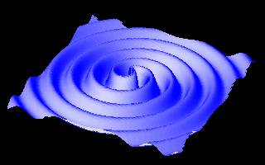
Gamma Ray Bursts
Prompt emission in Gamma, late-time emission with X-rays
Energetic explosions connected with collapse of massive stars or compact object mergers
Especially interesting is scenario when two compact objects merge within a collapsar
Electromagnetic signal accompanied by gravitational waves

Slide 3
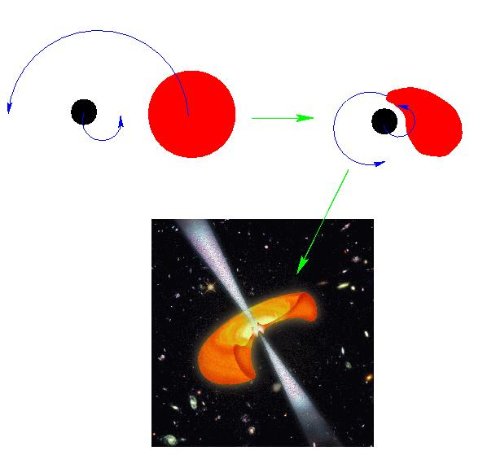
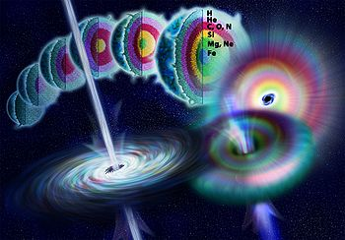
We unify the two “standard” models
Massive star explosion and mass fallback from the envelope
Paczyński (1998); McFadyen & Woosley (1999)
Compact binary merger: neutron star disruption
Eichler et al. (1989); Ruffert & Janka (1999)

Slide 4
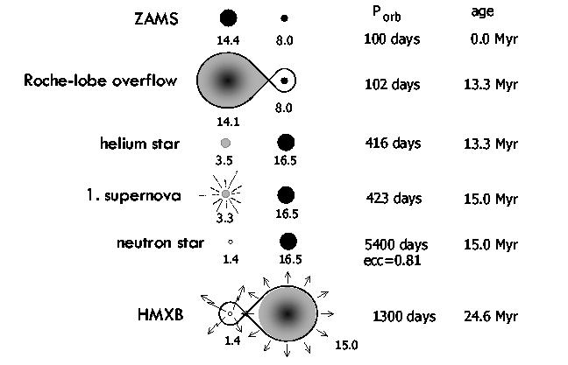
Compact companion enters the massive star's envelope
Common envelope phase, transient phase (analog of a Thorne-Żytkov object)
Trigger of the core collapse, SN (Hypernova) explosion -> GRB
Ultimate fate of HMXBs:
Binary pulsar
NS-BH
BH-BH

Slide 5
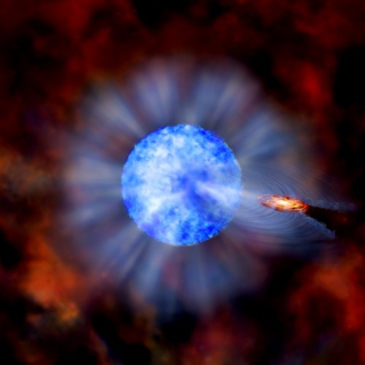
Possible progenitors: known high mass X-ray binaries
Close binary: massive OB star plus compact remnant
Examples: Cyg X-3, IC 10 X-1, NGC 300 X-1, M33 X-7
Statistics: the advanced LIGO/VIRGO detection rate of BH-BH mergers from Cyg X-3 formation channel is estimated at 10 yr⁻¹
BH HMXBs formed at z>6 might have impact on cosmic reionisation. Their fraction should increase with redshift
Zhang & Fryer (2001); Barkov & Komissarov (2010); Church et al. (2012); Belczyński et al. (2013); Mirabel et al (2011)

Slide 6
Our scenario
Close binary: massive OB star plus compact remnant (BH)
We consider four phases:
(1) Massive star is spun up by the interaction in binary system and then by the orbiting BH inside the envelope
(2) Core collapse and accretion of inner envelope, evolution of primary BH mass and spin
(3) Binary black hole merger
(4) Final accretion of the envelope onto the merger product

Slide 7
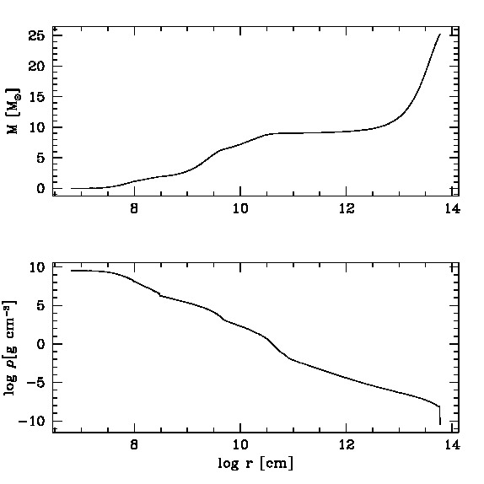
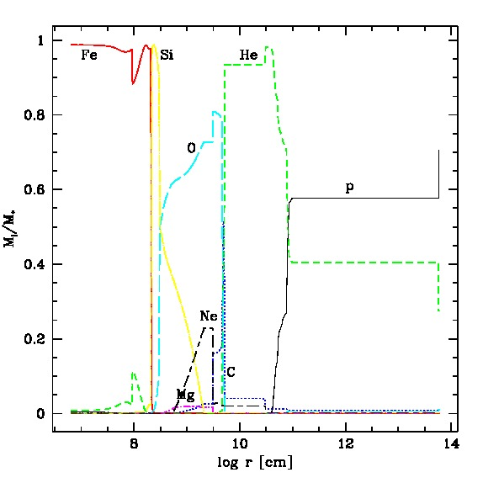
Model of pre-supernova star
Pre-supernova star (Woosley & Weaver 1995)
Enclosed mass of 25 M_{Sun}
Density distribution: chemical composition of an evolved star (Fe, Si, C, O, He, H)
Iron core of mass 1.4 M_{Sun}

Slide 8
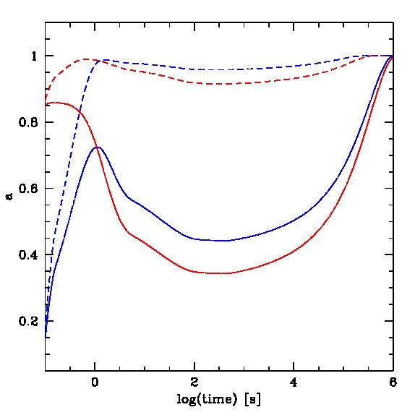
Spinning up the envelope and core black hole
We adopt specific angular momentum distribution in the star (differential rotation)
The infalling envelope matter adds mass and spins the black hole. The rotationally supported torus must obey (Bardeen et al. 1972):
This condition depends on time; AJ & Proga (2008); AJ, Moderski & Proga (2008)

Slide 9
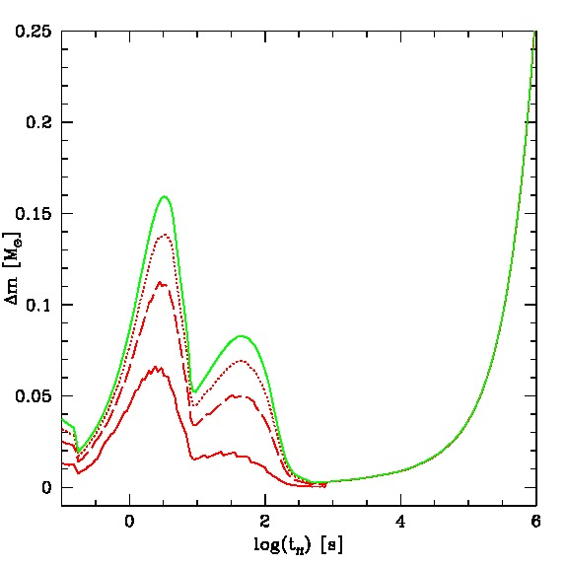
Mass of the envelope shell during the collapse (green:total; red: contained in the rotating torus).
The three lines show the models with various normalisation of the specific angular momentum in the envelope: x=1.5 (solid),
x=3.0 (dashed) and x=7.0 (dotted).

Slide 10
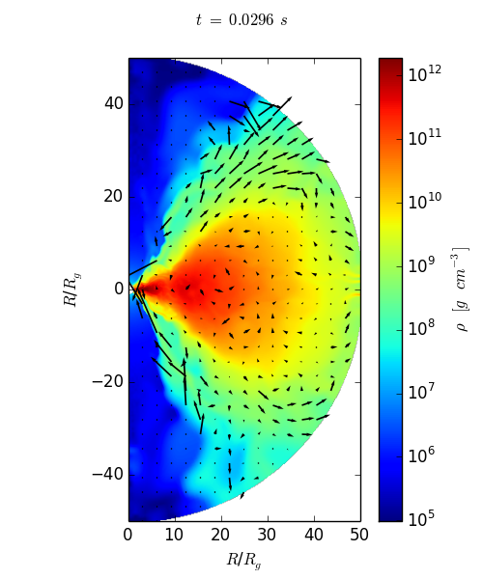
Mass loss through the wind
Wolf-Rayet stars: mass loss of 10⁻⁵ Msun/yr (e.g., Dwarkadas 2013)
Mass loss in MHD simulations: McKinney et al. (2006); Kumar et al. (2008); AJ, Mioduszewski & Mościbrodzka (2013); AJ & Kamiński (2014, in prep.);
See also: Proga (2004; 2007); Miller et al. (2006); AJ, Grzędzielski & Capitanio (2014, in prep.) → AGN/X-ray binaries winds from accreting BHs

Slide 11
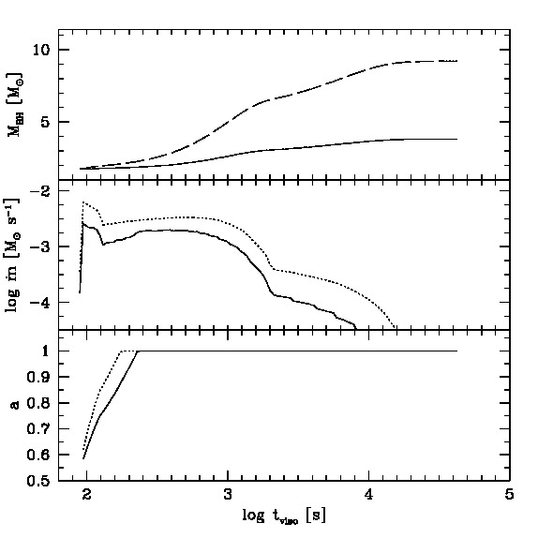
Spinning up the envelope and core black hole
The companion BH transfers the specific angular momentum
Torus accretion: BH spins up to maximum rate. Some (most ?) of its mass will be lost in wind.

Slide 12
Evolution scenarios
We proposed two representative scenarios for the pre-merger configuration
Homologous accretion of the total envelope, when both the rotating torus and material from the poles contribute to the growth of the primary black hole
Only torus accretion, while the material from the poles is expelled. Some torus mass might further be expelled through winds
The primary BH grows in mass to about ~3 – 9 MSun. This phase may last up to ~500 s (first jet emission). Then the secondary BH sinks to merge with it. The spin of the primary at merger time is above ~0.7.

Slide 13

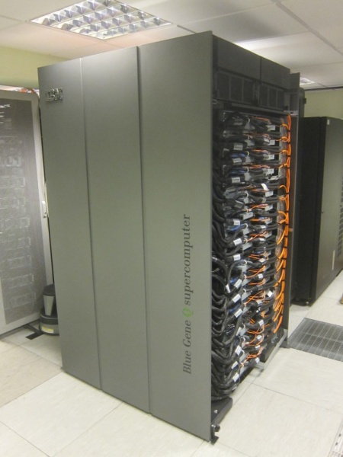
Merging two black holes
www.einsteintoolkit.org
Numerics done with Cactus Computational Toolkit (Goodale et al. 2003; Loeffler et al. 2012)
3+1 split of Einstein equations; Cauchy initial value problem solved with BSSN method (Shibata & Nakamura 1995; Baumgarte & Shapiro 1999)
3D Cartesian grid; adaptive mesh, reflection symmetry assumed to reduce number of grid points and computer requirements
Interdisciplinary Center for Mathematical and Computational Modeling, Warsaw University

Slide 14
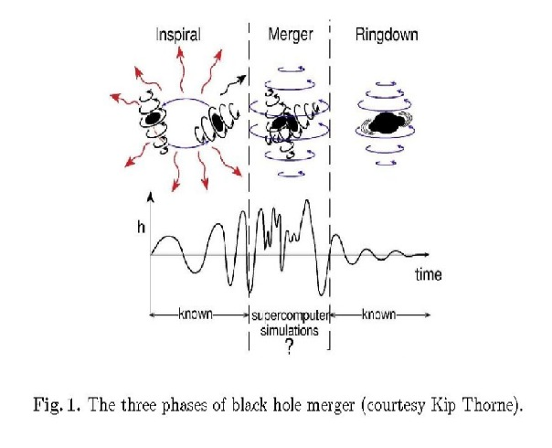
We track numerically the very last stage of BBH merger:
initial separation of 6M; inspiral, merger and ringdown
Quasicircular orbits, mass ratio q=1-3
Primary spin a=0-0.9, directed perpendicularly to orbital plane
Secondary is spinless

Slide 15

Apparent horizons of the binary BH components during merger
Parameters:
m1 = 0.632, m2 = 0.316, s1=0.9
ADM mass ratio M1/M2 = 3.0
Resulting final ADM mass and dimensionless spin
M3 = 1.34, a3 = 0.76

Slide 16
Merging event horizons

Slide 17
Gravitational recoil
Total linear momentum radiated from the system through gravitational waves is computed through the coefficients A^{lm} of multipole expansion of the Weyl scalar (Alcubierre 2008).
Recoil vector remains in the orbital plane, because we assumed reflection symmetry; in general, it does not have to be the case
We obtained velocity of the product, depending on spins and mass ratio of components, 200-300 km/s

Slide 18
Accretion of the remaining matter onto merged hole

Slide 19
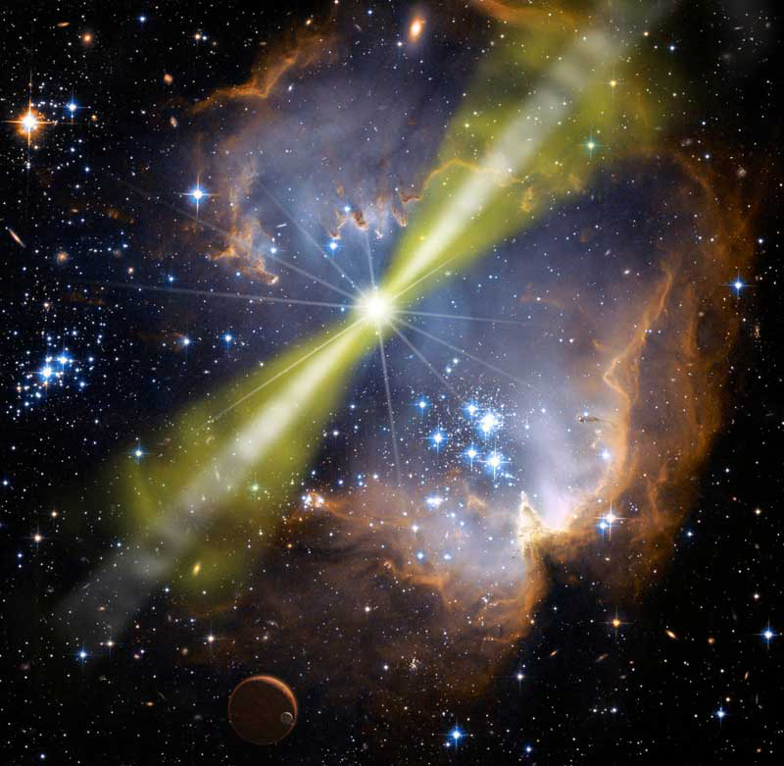
Observational perspectives
Large recoil speed for q~1 (for primary BH mass small due to wind taking most of envelope's), the offset of GRB afterglow is possible
The merger product would leave the GRB host galaxy if v~2000 km/s. Possible if both BHs have extremely large spins (Tichy & Maronetti 2007).

Slide 20
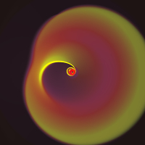
Theoretical perspectives
Recoil kick directed into circumbinary disk plane can alter the distribution of specific angular momentum (Rossi et al. 2010).
If magnetic fields are involved, expansion of dual jets driven by generalized Blandford-Znajek mechanism (Palenzuela et al. 2010)

Slide 21
Summary
  The long duration GRB may originate from a merger of a close compact binary system, containing a high mass evolved star and a black hole.
  The event can be divided into stages:
  Onset of the core collapse in the primary star, connected with the tidal interaction with secondary black hole. The inner shells of the envelope are spun up by the companion, and accrete onto the primary BH, increasing its mass and rotation spin
  The merger of two black holes, surrounded by a circumbinary torus; gravitational waves; kick
  Accretion of a remnant mass onto the BH merger product
  Possible observational consequences
      Electromagnetic signal from the jets, POSSIBLY DOUBLE
      Gravitational wave signal in between the jets
      Possible delay and offset of the second GRB signal (or its afterglow emission), due to recoil
      Possible precession/interaction between two jets flows if redirected

Slide 22

Now you are welcome to the jungle of black hole binaries that tend to have a huge appetite for destruction...
So let us jump to the paradise city of numerical simulations where it's so easy to say that 'anything goes'

